Slide 1

Project Phase 1 Presentation Fuel Quantity Detector Presented by Ishan Modi (Exam Seat No: T150953041) Malay Sheth (Exam Seat No: T150953063) Ritu Swain (Exam Seat No: T150953072) Guided by Prof. Smita Kadam
Dept. of Electronics and Telecommunication
Hope Foundation’s
International Institute of Information Technology Hinjawadi Pune

Slide 2

Outline
Introduction
Literature survey
Gap Identification
Problem statement and Objectives
Proposed Methodology
Requirement analysis
Impact analysis
Professional Ethical practices to be followed
System Implementation
Results and discussion
Conclusions and Future Scope
References

Slide 3
Introduction
The present world that we live in, where ever our eyes steer there we can see variants of automobile. Life has become faster due to them and so has it increased the fuel consumption rate. But the real question is the fuel consumption data that they show us actually true?
Why does it matter?
Oh it does.
Especially when you are a general public who reads, hears about fuel theft. The worse part is you are a victim even without knowing that you are.
Therefore here we are designing a project to eliminate this theft. A project that is based on ultrasonic fuel detection system. The Ultrasonic sensor in the setup will help detect the present fuel quantity in your tank to give you clarity regarding the actual fuel status. This will protect you from being a victim of fuel theft.

Slide 4
Literature survey
In an article, “Real Time Generator Fuel level Measurement Meter Embedded with Ultrasound Sensor and Data Acquisition System” by Sadeque Reza Khan and Arifa Ferdousi, mentions Ultrasonic sensors are characterized by a low-cost and by the possibility of being used in environments and situations where it is not possible to use more complex sensors as camera systems and laser devices.
Saikat Patra and Shibendu Mahata “Electronic for you November 2020 edition” HC-SR04 ultrasonic sensor module. The ultrasic ranging module HC-SR04 provides a 2 cm to 400 cm non contact measurement function.

Slide 5
Gap Identification
The only way of knowing your fuel quantity in the present time is through the fuel pump’s digital screen.
But you can’t exactly be assured with that as they could be the ones involved in the scheme of fuel theft.
Therefore we have proposed this solution that will work at an individual and personal level to keep you updated at all times regarding the fuel filling at various petrol pumps.

Slide 6
Problem statement and Objectives
Problem statement
Real Time Monitoring of Fuel Quality and Quantity
Objectives
Real time quantity detection of fuel in the tank.

Slide 7
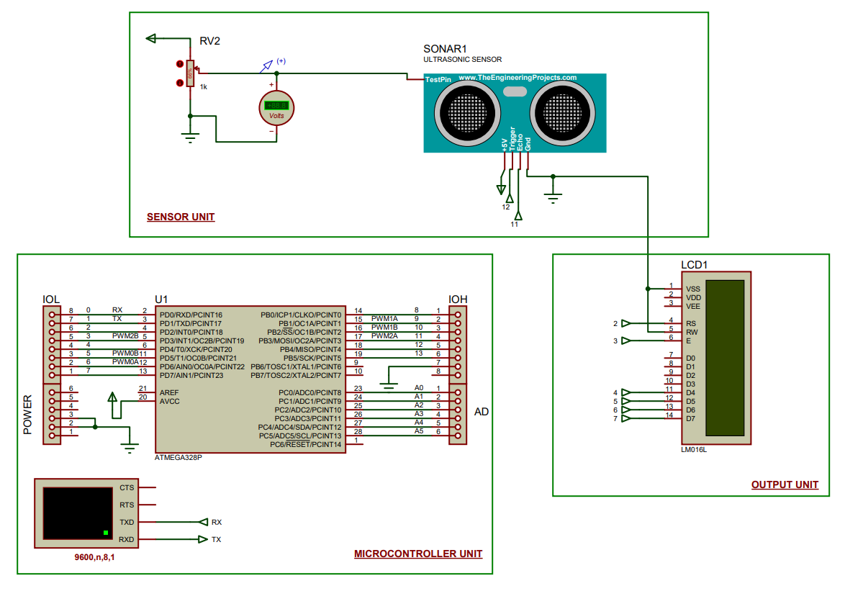
Circuit Diagram

Slide 8
Proposed Methodology
Our proposed system consists of an ultrasonic sensor to detect the fuel level and a LCD display to show the values.
Ultrasonic sensors are known for their low-cost and easy availability to complete several distance finding requirements.
Therefore in this work, HC SR-04 which is ultrasonic electric telemeter module was employed as ultrasonic transmitter and receiver.
This has come handy to find the fuel level inside the tank letting you the real time fuel quantity.
This module can measure a distance within 2 cm to 400 cm effectively and transform the data into impulse of different width.
At first 5us, pulse is applied through the pin SIG of the module which triggers the transmitter to generate 40 kHz ultra sound signal string.
At the moment the receiver catches the reflected wave it generates a high pulse width which corresponds to the time that the signal takes to reflected back.
By using this pulse width we can measure the distance as well as the fuel level.

Slide 9
Proposed Requirement analysis
Resources required:
5V battery
Mounting base for holding the embedded circuit.
Modern engineering tools:
PCB
3D printer for mounting base.
Techniques:
Soldering
PCB etching
3D printing
Drilling

Slide 10
Impact analysis
Impact of our project on society and environment:
Usefulness (positive impact):
LCD helps you see the quantity of fuel present in tank and prevents you from being cheated at fuel pumps.
Harmfulness (negative impact):
The major problem with this system is that, if proper connection is not done then due to short circuit there will blast in petrol tank.

Slide 11
Professional Ethical practices to be followed
Professional ethics:
Giving credits
Keeping technical guidelines in mind
Following the norms of engineering practices
For outcome caused by one’s actions or decisions
Responsibilities:
Complete daily/regular responsibilities
Moral responsibility, that is looking ahead to and caring about what happens to oneself and others.
Liability (answerability for one’s actions or decisions)
Norms of engineering practices to be followed:
Wearing glasses to avoid eye damages
Double check the circuit connections

Slide 12
System Implementation
Understanding system needs.
Selecting the components accordingly.
Software selection
Circuit designing
Stimulation
Circuit debugging
PCB designing
PCB debugging

Slide 13
Results and discussion
The proposed idea consists of ultrasonic technique for fuel measurement that acquires the measured fuel level and sends to the display unit which is present on the dash board. The data acquired from the sensor is given to the microcontroller . The processor processes the data by calculating the liter value that send to the display unit.

Slide 14
Conclusions and Future Scope
Conclusions:
Taking the result into consideration we can state that the system displays real time fuel quantity accurately.
Future Scope:
Fuel quality

Slide 15
References
Deep Gupta, Brajesh Kr. Singh and Kuldeep Panwar “A Prototyping Model for Fuel Level Detector and Optimizer” page no 226- 229
Saikat Patra and Shibendu Mahata “Electronic for you November 2020 edition” page no. 75-76.
African Journal of Basic & Applied Sciences 4 (6): 226-229, 2012 ISSN 2079-2034. 5.
Lei Chan, Xinmin Dong and Jie Han’s Development of Ultrasonic instrument for sealed container’s liquid level measurement.
“Real Time Generator Fuel level Measurement Meter Embedded with Ultrasound Sensor and Data Acquisition System” by Sadeque Reza Khan and Arifa Ferdousi

